Slide 1
CV in Law Enforcement + Text Recognition
Lucas Cheek CS460

Slide 2
CV?
Computer Vision is a field of computer science that centers on gathering useful data from generic images
Cameras are incredibly common, cheap(ish), and great at capturing the “big picture”, where a more specialized sensor would give a limited view of the world

Slide 3
CV/Law Enforcement
Large scale surveillance is becoming increasingly commonplace
CCTV, Traffic cameras, body cameras, etc.
As the scale of the data increases, task automation becomes vital to make effective use of the equipment

Slide 4
CV/Law Enforcement/Traffic Cameras
Traffic cameras have been a staple in many states for years. Automatic detection of a violation is very reliable with the right sensors, and these systems provide a complete package of evidence (time stamp + photographs from optimal angles)
The problem lies in the sheer volume of data, especially in urban areas. It can take weeks for an infraction to be processed and ticketed manually.
This is an ideal application for CV. If the license plate number of an offending vehicle can be automatically extracted, the workload for police is greatly reduced.
Commonly called ANPR (Automatic Number Plate Recognition)
Notes:
Most states in the US legally require a personal verification step in ticket processing. However, some countries (like Australia) allow this process to be completely automated, from the original picture to the mailing of the ticket.

Slide 5
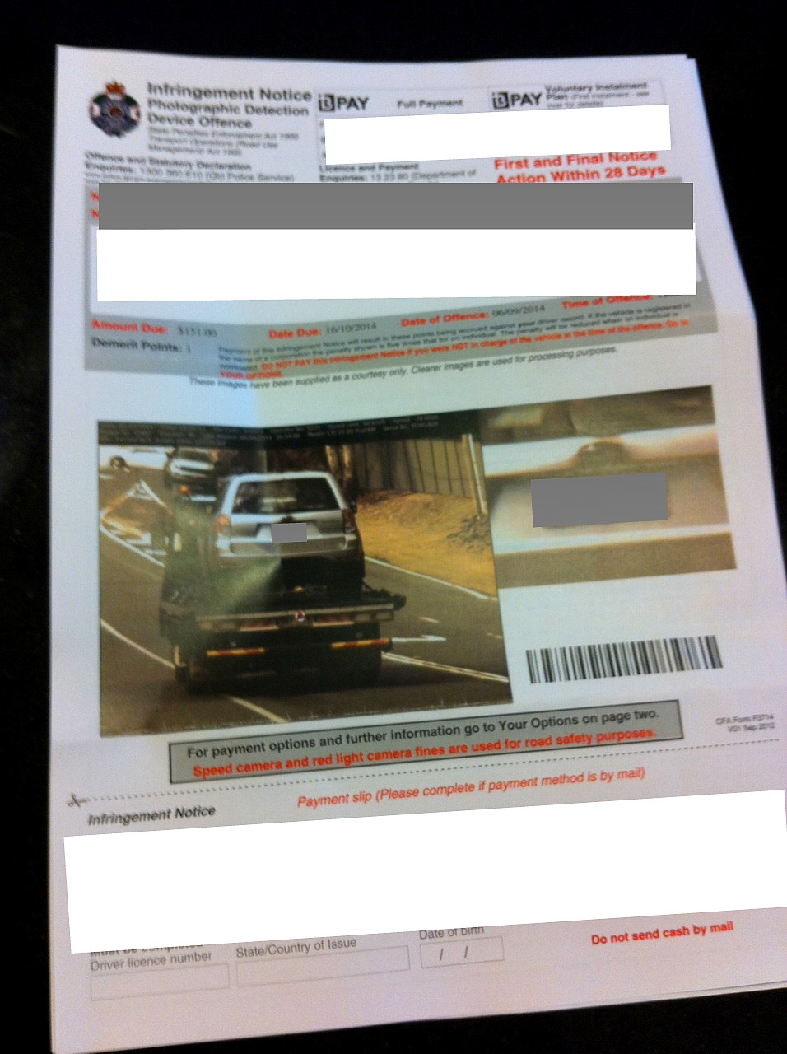
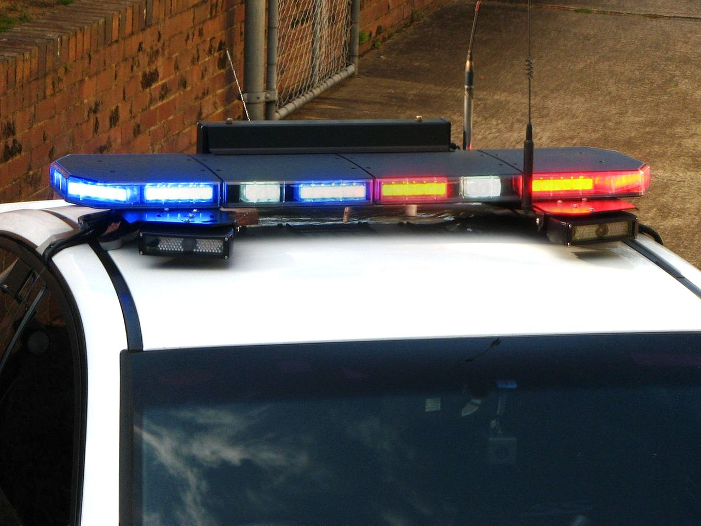
Problems….
Notes:
Left: Australia, traffic cam system automatically ticketed the car being towed
Right: Australia, mobile ANPR for detecting vehicles of interest

Slide 6
Are these really problems?
In terms of a mistaken traffic cam, a reasonable police force would quickly void a violation. However:
That is forcing your unwitting and unwilling end user to do your error handling
What if the mail gets lost?
In the case of universal mobile surveillance: I suppose it depends on the populace, but most people would find that creepy at best and Machiavellian at worst.

Slide 7
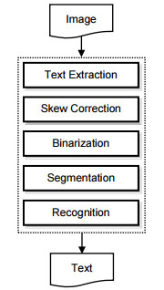
How does ANPR work?
Essentially an applied form of OCR (Optical Character Recognition)
Notes:
Image: a high level example of an OCR system
From “Design of an Optical Character Recognition System for Camera-based Handheld Devices”

Slide 8
Text Extraction
Generally the toughest part of OCR in natural settings – what is text and what isn’t?
If you feed arbitrary contours through an ML that is trained to recognize characters, it will do just that with everything, making the data difficult to use.
There are numerous general methods for this, all with fairly low accuracy (+-70%)
For example: SWT, trained feature matching, intensity variation
Notes:
Stroke Width transform, described in “Detecting Text in Natural Scenes with Stroke Width Transform,” where a scene’s edges are analyzed for areas with consistent stroke width
Trained feature matching described in “Text detection and character recognition in Scene Images with Unsupervised Feature Learning,” which uses a trained ML algorithm to detect regions with text-like patterns.
Intensity variation: described in “Design of an Optical Character Recognition System for Camera-based Handheld Devices”, which separates an image into n blocks, which are individually analyzed via intensity variance (high contrast = text) and grouped based on location.

Slide 9
Text extraction in ANPR
ANPR has a massive advantage here as there are known elements to a traffic cam image
The ROI is a region of high contrast
The text skew is minimal, or at least consistent
The text is readable from a distance and in low visibility conditions

Slide 10
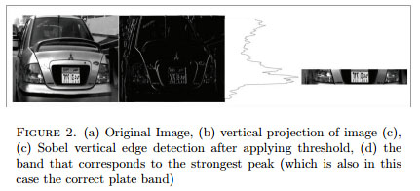
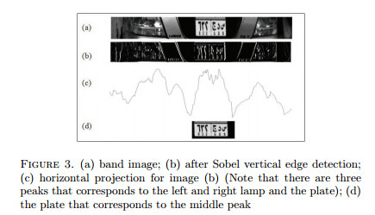
Text extraction in ANPR
Notes:
Figures from “Automatic Number Plate Recognition System”. Paper describes a license plate localization method where the plate is localized by finding peaks in variance on vertical and horizontal bands in an image filtered for edge detection
Additional note: Plate origin can be determined here via an ML algorithm that has been trained on different plate styles

Slide 11
Binarization+Segmentation
Once the image has been localized to regions of text, an OCR can then process the image and draw contours around the letters for later recognition.
Binarization is a low-cost image process that turns the image into pure black and white based on a threshold
Segmentation can be done via a contour-building function that will create individual polygons that match the edges in the binary image. Extraneous contours can be weeded out at this stage via a filter (area of polygon, location in image, etc.)
Once done, the program has a tidy representation of all of the individual characters in the image and their locations.

Slide 12
Recognition
There are numerous text recognition algorithms and programs, all with similar (high) levels of accuracy given adequate training data and a good sample.
Examples: OCRTesseract, K-Nearest Neighbors
Notes:
OCRTesseract: a program developed by HP in the early 90s that was released as open source in the early 2000s and is currently curated by Google. Has a great success rate, but requires an ideal image (no skew, no large extraneous thresholds.) Works using a two-pass system, where the first pass identifies letters with high confidence, and the second pass uses positive results from the first to better recognize remaining characters (useful for different languages or odd fonts)
Knearest: discussed next

Slide 13
K-Nearest Neighbors
I explored this ML algorithm for text recognition as part of my project
Works similarly to our homework – A collection of known samples are designated to their respective character, and fed into the training algorithm
The training algorithm can then make a ranking system based on best matches to training data through by direct correlation (Matrix matching.) A similar algorithm, SVM (Support Vector Machine), only looks at identified key features rather than the whole image

Slide 14
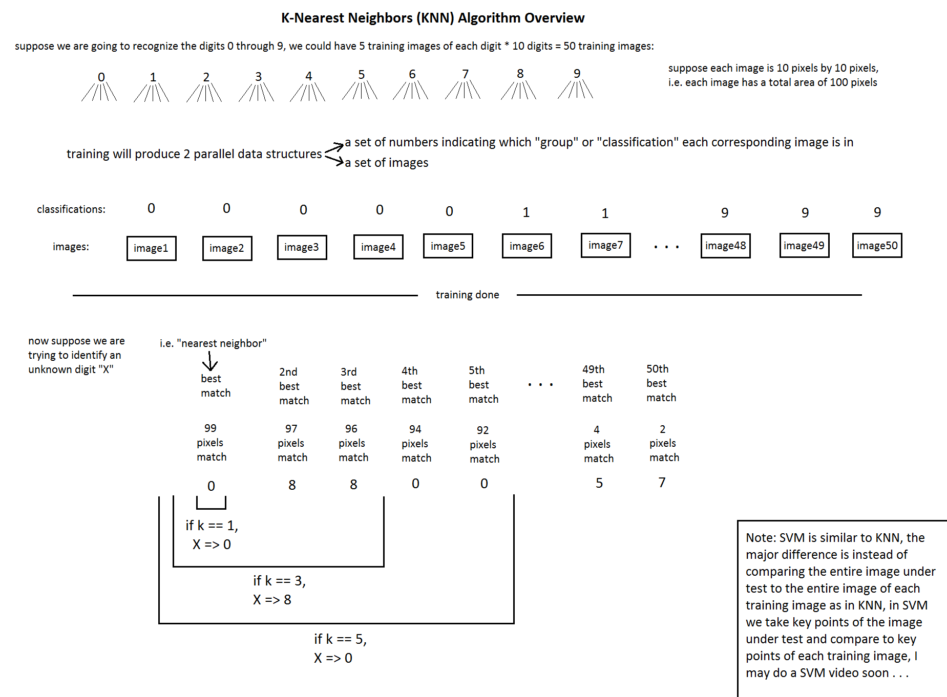

Slide 15

Exploration of KNN
I used OpenCV in C++ to process a set of 62992 training images from the Char74K dataset.
I then trained the Knearest algorithm (also available in OpenCV) and applied it to a processed test image:
Code based on a KNN tutorial by Chris Dahms, which I modified to accommodate the Char74k dataset, along with some efficiency+compatibility upgrades to make it work with OpenCV 3.0.0.
I also added some additional features, like complete English character set (upper and lowercase) recognition instead of just numbers.
Notes:
Show code now

Slide 16


Sample Processing

Slide 17
Back to Law Enforcement: Future Applications
At a recent conference (May this year,) the CCC outlined a 10-year plan in CV task automation for police body-cameras:
Automatic redaction of sensitive material for FOIA servicing (street names, store fronts, faces, etc.)
Forensic search and triaging: the automatic generation of contextual metadata for a particular video, such as time/date, locations, and notable events
Early warning systems: Automatic detection of questionable behavior by officers, such as excessive and premature use of force
Some of these tasks, like the automatic redaction, could be done somewhat reliably with today’s CV technology. Other tasks, like the “early warning system” would have to involve a very sophisticated pattern recognition system and possibly an expanded sensor suite.
Notes:
CCC: Computing Community Consortium

Slide 18
References
"Video Analysis for Body-worn Cameras in Law Enforcement." Computing Community Consortium, May 2015. http://cra.org/ccc/wp- content/uploads/sites/2/2015/01/CCCWhitepaperonBodyCamerasinLawEnforcement.pdf
"Automatic Number Plate Recognition System." Annals of University of Cralova, Mathematics and Computer Science Series 38.1223-6934: 62-71. http://inf.ucv.ro/~ami/index.php/ami/article/viewFile/388/351
"Towards Text Recognition in Natural Scene Images." Computational Intelligence Laboratory, Institute of Informatics and Telecommunications 153.10. http://users.iit.demokritos.gr/~bgat/icta2005.pdf
"Text Detection and Character Recognition in Scene Images with Unsupervised Feature Learning." Computer Science Department, Stanford University. http://crypto.stanford.edu/~dwu4/papers/ICDAR2011.pdf
"Optical Character Recognition by Open Source OCR Tool Tesseract: A Case Study." International Journal of Computer Applications 55.10. http://research.ijcaonline.org/volume55/number10/pxc3882784.pdf
"Design of an Optical Character Recognition System for Camera-based Handheld Devices." International Journal of Computer Science 8.1. http://arxiv.org/ftp/arxiv/papers/1109/1109.3317.pdf

